Slide 1

Driver Drowsiness and Distraction Detection System using computer vision
KNOWLEDGE INSTITUTE OF TECHNOLOGY

Slide 2
Driver Drowsiness and Distraction Detection System Using Computer Vision
KNOWLEDGE INSTITUTE OF TECHNOLOGY
Objective: Develop an AI-based Driver Monitoring System to detect driver drowsiness and distraction in real time, improving road safety by monitoring the driver's condition continuously.
Solution: Developed using Python, OpenCV, MediaPipe, and YOLOv8 to detect drowsiness, yawning, head movement, and mobile phone usage, while providing real-time alerts, event logging, and screenshot capture.
Impact: Improves road safety by detecting fatigue and distracted driving at an early stage, helping prevent accidents through continuous monitoring and timely warnings.

Slide 3
Engineering Design Process
KNOWLEDGE INSTITUTE OF TECHNOLOGY
Requirement & Planning: Defined project objectives, identified driver monitoring requirements, and designed the overall AI-based system architecture.
System Development: Developed drowsiness, yawning, head position, and mobile phone detection modules using Python, OpenCV, MediaPipe, and YOLOv8.
System Integration: Integrated all detection modules with a real-time monitoring dashboard, event logging, and screenshot capture into a unified driver monitoring system.
Testing & Validation: Evaluated system performance under different driving scenarios to verify detection accuracy and real-time response.
Documentation: Prepared technical documentation, project report, system workflow, and presentation materials.

Slide 4
Process Table
KNOWLEDGE INSTITUTE OF TECHNOLOGY
Phase | Engineering Steps | Key Activities & Outcome
I. Definition | Requirement Analysis, Concept Design | Defined: Driver monitoring system to detect drowsiness and distraction in real time. Concept: AI-based Computer Vision system using OpenCV, MediaPipe, and YOLOv8.
II. Development | System Design, Module Development, Integration | Developed: Drowsiness, yawning, head position, and mobile phone detection modules. Integrated: Real-time dashboard, event logging, screenshot capture, and alert system.
III. Realization | Prototype, Testing, Validation | Built: Functional AI-based driver monitoring prototype using a webcam. Validated: Real-time detection accuracy, system performance, and driver safety alerts under different scenarios.

Slide 5
List of Activities
KNOWLEDGE INSTITUTE OF TECHNOLOGY
A. Literature Survey: Studied AI-based driver monitoring and computer vision techniques.
B. Requirement Analysis: Identified system requirements, modules, and architecture.
C. Eye & Face Detection: Developed facial landmark detection for drowsiness monitoring.
D. Yawning & Head Detection: Implemented mouth and head movement analysis for fatigue detection.
E. Mobile Phone Detection: Integrated YOLOv8 for real-time phone usage detection.
F. System Integration: Combined OpenCV, MediaPipe, YOLOv8, dashboard, logging, and alerts.
G. Testing & Validation: Tested detection accuracy, real-time performance, and system reliability.

Slide 6
Activity Duration Table
KNOWLEDGE INSTITUTE OF TECHNOLOGY
ID | Activity Description | Duration (Hours)
A | Requirement Engineering | 30
B | Concept Design | 27
C | Embodiment & Detail Design | 42
D | Software Development | 55
E | System Integration | 28
F | Testing & Optimization | 38
G | Documentation & Presentation | 30
Total | Project Duration | 250 Hours

Slide 7
Activity Precedence Table
KNOWLEDGE INSTITUTE OF TECHNOLOGY
ID | Activity | Predecessor
A | Requirement Engineering | —
B | Concept Design | A
C | Embodiment Design | B
D | Detail Design | C
E | Software Development | D
F | System Integration | E
G | Testing & Optimization | F
H | Documentation & Presentation | G

Slide 8
Glossary:
KNOWLEDGE INSTITUTE OF TECHNOLOGY
AI (Artificial Intelligence): Enables intelligent analysis of driver behavior.
Computer Vision: Technology used to analyze images and videos in real time.
OpenCV: Open-source library for image processing and computer vision.
MediaPipe: Framework used for face landmark detection and tracking.
YOLOv8: Deep learning model used for real-time mobile phone detection.
EAR (Eye Aspect Ratio): Measures eye closure to detect driver drowsiness.
MAR (Mouth Aspect Ratio): Measures mouth opening to detect yawning.
Driver Monitoring System (DMS): Monitors driver alertness and distraction to improve road safety

Slide 9
Core Technologies & Principles
KNOWLEDGE INSTITUTE OF TECHNOLOGY
Computer Vision: Analyzes real-time video frames to monitor driver behavior.
Artificial Intelligence (AI): Detects drowsiness and distraction using intelligent algorithms.
OpenCV: Performs image processing and real-time video analysis.
MediaPipe Face Mesh: Detects facial landmarks for eye, mouth, and head position analysis.
YOLOv8: Detects mobile phone usage using deep learning-based object detection.
Eye Aspect Ratio (EAR): Identifies drowsiness by measuring eye closure.
Mouth Aspect Ratio (MAR): Detects yawning by analyzing mouth opening.

Slide 10
Concept Rules & Laws
KNOWLEDGE INSTITUTE OF TECHNOLOGY
Computer Vision Principle: Processes real-time video frames to monitor driver behavior.
Facial Landmark Detection: Uses facial landmarks to analyze eye, mouth, and head movements.
Deep Learning Principle: Applies the YOLOv8 model for accurate mobile phone detection.
Real-Time Monitoring: Continuously detects drowsiness and distraction and provides instant alerts.

Slide 11
System Components & Technologies
KNOWLEDGE INSTITUTE OF TECHNOLOGY
Technology | Purpose
Python | Core programming language
OpenCV | Image processing and video analysis
MediaPipe Face Mesh | Facial landmark detection
YOLOv8 | Mobile phone detection
NumPy | Mathematical and array operations
CSV Logger | Stores driver event records
Webcam | Captures real-time driver video

Slide 12
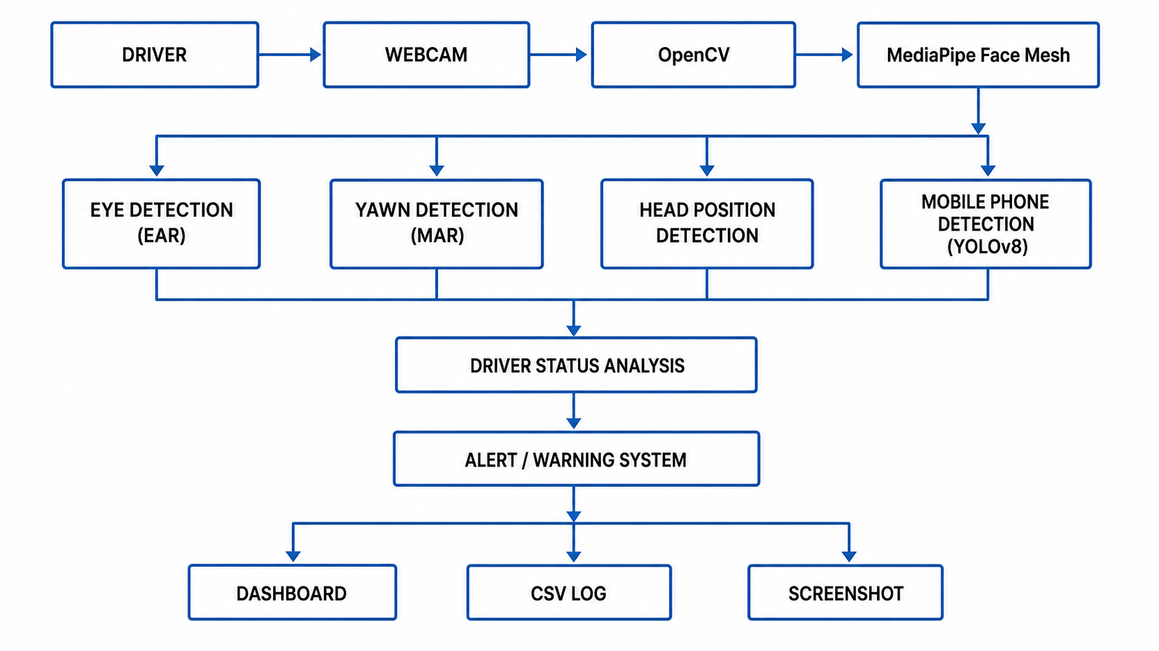
KNOWLEDGE INSTITUTE OF TECHNOLOGY
System Model

Slide 13
What-if-Analysis
KNOWLEDGE INSTITUTE OF TECHNOLOGY
Scenario | Expected System Response
Driver Not Detected | Displays "No Driver Detected" and waits until a face is detected.
Driver Drowsiness Detected | Displays a DROWSY alert, captures a screenshot, and logs the event.
Yawning Detected | Displays a YAWNING warning and records the event in the log.
Mobile Phone Usage Detected | Displays a DISTRACTED alert and stores the event details.
Driver Looking Away | Detects head distraction, updates the dashboard, and generates a warning.

Slide 14
Conclusion
KNOWLEDGE INSTITUTE OF TECHNOLOGY
The Driver Drowsiness and Distraction Detection System Using Computer Vision successfully monitors driver behavior in real time by detecting drowsiness, yawning, head movement, and mobile phone usage. Developed using Python, OpenCV, MediaPipe Face Mesh, and YOLOv8, the system provides timely alerts, event logging, and screenshot capture to enhance driver awareness and safety. This project demonstrates the practical application of Artificial Intelligence and Computer Vision in reducing fatigue- and distraction-related road accidents while providing a scalable foundation for future Advanced Driver Assistance Systems (ADAS) and intelligent transportation solutions.

